Slide 1
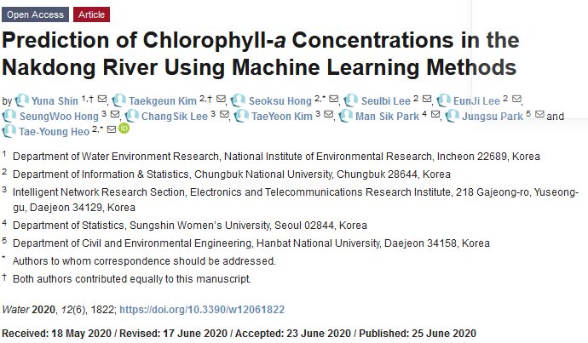

Slide 2
Models:
SVR, Bagging, XGBoost, Random Forest, RNN, LSTM
Target:
Chl-a Concentration at Dasa weir along Nakdong river, Korea using observations from 6
Weirs upstream.
Data:
Collected from 7 weirs.
Daily data from June 2015 to November 2017 (871 days) for training
Daily data from December 2017 for validation (31 days).
1% of measurements replaced by KNN
Weather data: avg temp, sunshine, rainfall, inflow, outflow
Water quality data: water temp., pH, EC, DO, TOC

Slide 3
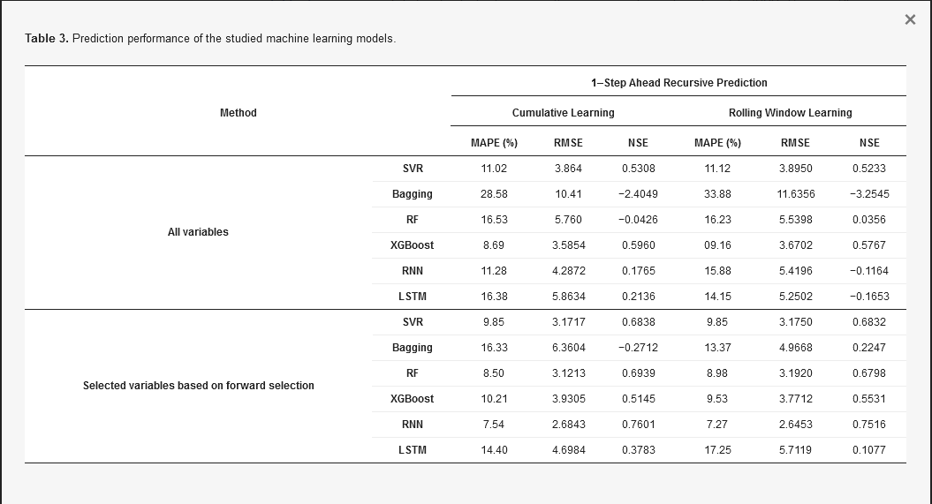
Matrices:
Major conclusions:
RNN better than ML models

